Slide 1

BUSINESS OPPORTUNITIES
IN CAMEROON AND CENTRAL AFRICA
African Economic Development Week
Notes:
This presentation demonstrates new features in PowerPoint, which are optimized for slideshow viewing. These slides aim to give you ideas for creating engaging presentations in PowerPoint 2010.
For more sample templates, click the File tab, and then on the New tab, click Sample Templates.

Slide 2

Preview from Cameroon and Central Africa
1
2
3
Map of the Region
Key statistics (Pop; GDP, TC)
Strategic advantages

Slide 3

Area
1

Slide 4
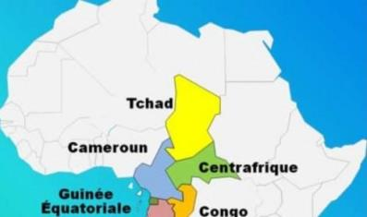
Area
Described as “Africa in miniature” for its geographical and human diversity, Cameroon is also considered the economic heavyweight of Central Africa.
.
The country has the most diversified economy in the region. Cameroonian GDP growth has been steady since 2008 and has remained above 5% since 2012.
The growth strategy implemented, with the support of international donors, provides for major structuring projects in numerous sectors.
Furthermore , the Cameroonian market has numerous foreign establishments, particularly in Douala, including around a hundred French subsidiaries, around 200 companies belonging to French nationals, but also national public and private groups, some of which operate throughout the region .
Given its geographical position, the economic capital of Cameroon (or even of CEMAC) has become the hub for trade and business with the countries of the sub-region (Chad, Central African Republic, northern Congo and northern Gabon).

Slide 5

Statistics keys
2
(population, GDP, growth rate)

Slide 6

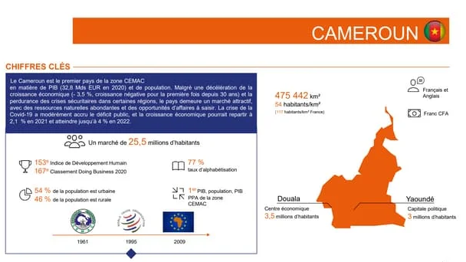


Key
Cameroon is the leading country in the CEMAC zone in terms of GDP (32.8 billion Euros in 2020) and population. Despite a negative economic growth declaration (-3.5%, negative growth for the first time in 30 years) and the persistence of security crises in certain regions, the country remains an attractive market, with abundant natural resources and business opportunities to seize.

Slide 7
Strategic
3
(location, natural resources)

Slide 8

Strategic
Cameroon has relatively diversified resources compared to other countries in the region, such as forestry, agriculture, petroleum and mining (notably aluminum). The hydroelectric potential is significant, and efforts to improve infrastructure are underway .
This context , the developer did not fail to attract investments:
Cameroon thus captured 487 billion in direct investments
foreigners in 2021, an increase of 43% compared to 2020 .
These incoming flows of Foreign Direct Investment have notably made it possible to support dynamism in the hotel, manufacturing and finance sectors. Furthermore, the country, which is increasingly subject to flooding, deforestation, recurring droughts in the north and an uncertain duration of rainy seasons, has decided to move towards a green development model.
The share of renewable energies in the electricity mix should reach 25% in 2035, compared to 2% in 2019 .
Between its increasing investments and its state voluntarism, Cameroon therefore offers a large number of opportunities in the mining, infrastructure, finance, hotel sectors, and of course renewable energies.

Slide 9
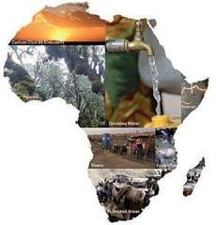
advantages (Next 1)
1. Cameroon's central geographic location in Central Africa makes it a strategic connection point for investments in the region, facilitating access to regional and international markets.
2. Cameroon benefits from a wide diversity of natural resources , including oil, natural gas, minerals and arable land, providing numerous investment opportunities in various sectors.
3. The country also has significant hydroelectric potential , with rivers such as the Sanaga, Nyong and Dja providing investment opportunities in the renewable energy sector.
4. In addition to its natural resources, Cameroon is blessed with a skilled and cheap labor force , giving investors a competitive advantage in terms of production costs.
5. The Cameroonian government has implemented policies favorable to foreign investment , including tax incentives and free zones, making it easier for foreign companies to set up in the country .

Slide 10

advantages (Next 2)
6 . Cameroon's transport network is well developed, providing quality infrastructure for the transport of goods and thus facilitating trade with neighboring countries.
7. By investing in Cameroon, businesses can also benefit from the proximity to the Central African Economic and Monetary Community (CEMAC) , offering a market of more than 50 million potential consumers.
8. The country offers a stable political climate and a conducive business environment , which reduces risks for foreign investors and ensures the security of their investments.
9. The infrastructure sector in Cameroon is in full development , offering numerous investment opportunities in the construction, transport and telecommunications sectors .

Slide 11


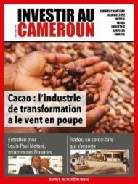


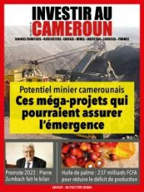
advantages (Next 3)
In summary, investing in Cameroon and Central Africa has undeniable strategic advantages in terms of geographic position, abundant natural resources, skilled labor and investment-friendly policies.

Slide 12
Preview from Cameroon and Central Africa
1
2
3
4
Agriculture
Mining
Forest
Tourism
5
6
7
8
E-Commerce
Healthcare
Real Estate
Education

Slide 13
AGRICULTURE
1
( coffee, cocoa, bananas)

Slide 14
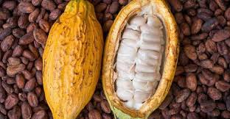
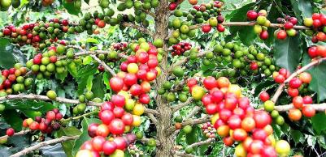
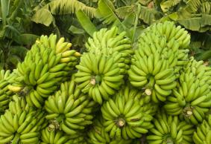
BROADCAST IT
Cameroon is a key player in the coffee, cocoa and banana sectors in Africa, and these sectors play a crucial role in its economy. When it comes to coffee, Cameroon is one of the main producers on the continent, with an average annual production of around 120,000 tonnes. The country mainly exports its coffee to the European Union, the United States and other international markets. When it comes to cocoa, Cameroon is also a major producer, with an annual production of around 290,000 tonnes. The quality of Cameroonian cocoa is recognized on the world market, making it a highly sought-after product by processors and chocolatiers.
Regarding bananas, Cameroon is one of the main producers in Africa, with production reaching around 250,000 tonnes per year. The country exports its bananas mainly to the European Union, Russia and the Middle East. The quality of Cameroonian bananas and the diversity of varieties produced make it an important player on the world market. These sectors offer attractive investment opportunities in Cameroon, supported by the growing demand for these products on a global scale. The statistics demonstrate the significant growth potential of these sectors and their importance in the economic development of the country.
Agriculture

Slide 15
MINES
2
1
(bauxite, cobalt, gold)

Slide 16
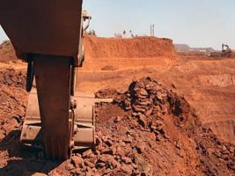
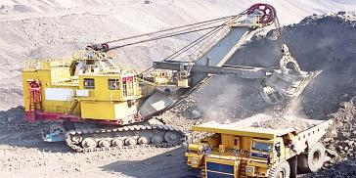

The mining sector in Cameroon has significant potential in terms of natural resources, particularly bauxite, cobalt and gold. Regarding bauxite, Cameroon has significant reserves of this ore, estimated at more than 200 million tonnes, making it one of the main producers in Central Africa. The country recently granted mining permits for the exploitation of bauxite, paving the way for investments in this sector. Regarding cobalt, Cameroon also has promising deposits, with production estimated at around 3,000 tonnes per year. Cobalt is a strategic mineral used in the manufacture of batteries, making it a highly sought-after resource on the global market.
Finally, regarding gold, Cameroon has significant gold deposits in the East and Adamaoua regions. The government has launched initiatives to promote responsible gold mining and is attracting investment in this sector. The country's gold production is increasing, with estimates of around 2 tonnes of gold being mined annually. These figures demonstrate the potential of bauxite, cobalt and gold mines in Cameroon, thus offering investment opportunities in the exploration, exploitation and processing of these mineral resources to contribute to the economic development of the country.
Mining

Slide 17
FOREST
3
1
( sustainable exploitation of wood)

Slide 18
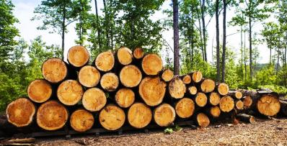
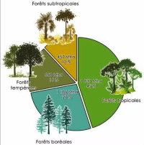
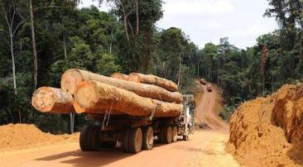
The timber sector in Cameroon is an important pillar of the economy, notably thanks to the sustainable exploitation of the country's forest resources. Cameroon has one of the largest forests in Central Africa, covering approximately 20 million hectares. With an average annual timber production of 30 million cubic meters, the country is one of Africa's leading timber exporters. The Cameroonian government has put in place strict measures to promote responsible and sustainable forest exploitation, which has enabled the country to benefit from the FSC (Forest Stewardship Council) label for some of its forest products.
The wood sector thus offers investment opportunities in wood processing and the marketing of derived products. Cameroon mainly exports timber to the European Union, China and the Middle East. Global demand for certified forest products is increasing, which positions Cameroon advantageously in the international market. Statistics show that the timber sector in Cameroon has significant growth potential, supported by responsible exploitation of forest resources and a growing demand for certified timber products.
Forest

Slide 19
TOURISM
4
1
( wildlife, national parks)

Slide 20
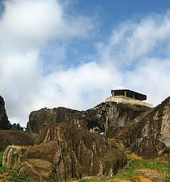

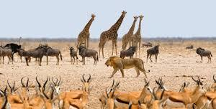
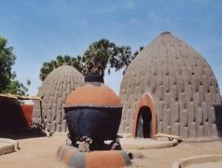

Cameroon has a rich and diverse ecosystem, offering unique tourism opportunities focused on wildlife and national parks. With a wide variety of animal species, including gorillas, elephants, lions, giraffes and many others, the country is a popular destination for safari and wildlife watching enthusiasts. National parks such as Waza National Park , Korup National Park and Bouba National Park Ndjida offers unforgettable safari and ecotourism experiences, attracting visitors from all over the world.
Cameroon's tourism potential in the area of wildlife and national parks is supported by promising statistics. Tourism contributes significantly to the country's economy, with a steady increase in the number of international visitors over the years. In 2019, Cameroon welcomed more than 1.5 million visitors, generating significant revenue for the tourism sector. The government's efforts to promote sustainable tourism and wildlife conservation are helping to strengthen Cameroon's appeal as a tourist destination, paving the way for investment opportunities in this growing sector.
Tourism

Slide 21
E-COMMERCE
5
1
( wildlife, national parks)

Slide 22


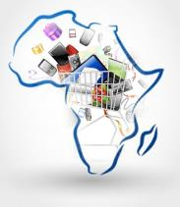
E-commerce in Africa has experienced remarkable growth in recent years, fueled by increasing technology adoption and improved access to the Internet across the continent. Online shopping platforms offer African consumers a convenient way to purchase goods and services, while enabling businesses to reach a broader audience, even in geographically distant areas. This digital transformation has created new economic and commercial opportunities in Africa, providing investors with lucrative prospects in this rapidly expanding sector.
The rapid growth of the e-commerce sector in Africa presents attractive investment opportunities for companies and entrepreneurs looking to capitalize on this growing market. Investments in online shopping platforms, digital payment solutions, and innovative logistics services are particularly sought after to meet the increasing demands of African consumers. By investing in companies well positioned to benefit from the growth of e-commerce in Africa, investors can achieve attractive returns and contribute to the evolution of the continent's commercial landscape.
Key statistics highlight the rise of online commerce in Africa, demonstrating significant growth in the number of Internet users and smartphone users in the region. For instance, Internet penetration rates in Africa have increased exponentially in recent years, creating new opportunities for e-commerce businesses. Additionally, forecasts indicate a steady increase in online sales volume and revenue generated by e-commerce in major African markets. These data confirm the promising potential of e-commerce as a thriving investment sector in Africa.
E-Commerce

Slide 23
HEALTHCARE
6
1
( wildlife, national parks)

Slide 24



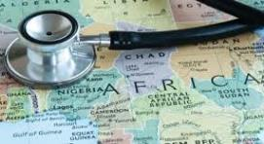

Africa's health sector presents a compelling opportunity for investment due to its growth potential and promising returns. This sector encompasses healthcare services, pharmaceuticals, medical devices, telemedicine, digital health solutions, and healthcare infrastructure development, all of which offer avenues for financial gains and the enhancement of healthcare access and quality for millions on the continent.
1. Growing Population and Disease Burden: Africa's population is rapidly increasing, expected to double by 2050, creating a substantial demand for healthcare services and products. The continent faces a significant burden of communicable diseases such as malaria, HIV/AIDS, tuberculosis, and neglected tropical diseases. Investments in healthcare can address these challenges and improve health outcomes for the expanding population.
2. Health Infrastructure Development: Many African countries are investing in upgrading healthcare infrastructure, including hospitals, clinics, and facilities. Strengthening healthcare infrastructure is vital to ensure quality healthcare access, particularly in underserved rural areas. Investors can participate in infrastructure projects to improve healthcare delivery across Africa.
3. Technology and Innovation: The adoption of healthcare technology and innovation is on the rise in Africa, revolutionizing healthcare access and delivery. Telemedicine, electronic health records, health information systems, and mobile health applications are reshaping the healthcare landscape. Investing in health tech startups and digital health solutions can yield significant returns while fostering healthcare innovation in the region.
4. Healthcare Financing and Insurance: Financial constraints often impede healthcare access in many African nations. Investing in healthcare financing mechanisms like health insurance schemes and micro-health insurance products can enhance healthcare affordability and access for low-income individuals. Private health insurance companies and healthcare financing institutions play a crucial role in expanding healthcare coverage in Africa.
Health

Slide 25
5. Public-Private Partnerships: Collaboration between the public and private sectors is crucial for fortifying Africa's healthcare system. Public-private partnerships leverage expertise and resources to tackle healthcare challenges, improve service delivery, and expand healthcare access. Investors can explore opportunities in healthcare PPPs to contribute to a sustainable and resilient healthcare system in the region.
6. Disease Prevention and Health Promotion: Investing in preventive healthcare measures and health promotion programs is key to reducing the burden of preventable diseases in Africa. Supporting initiatives such as immunization campaigns, maternal and child health programs, and awareness campaigns on lifestyle-related diseases can enhance public health outcomes and promote disease prevention.
7. Human Capital Development: Investing in healthcare education and training programs is essential for cultivating a skilled healthcare workforce to meet Africa's burgeoning healthcare needs. Training healthcare professionals, supporting medical education institutions, and providing continuous professional development opportunities are critical initiatives. Investment in human capital development elevates healthcare service quality and contributes to the overall enhancement of the healthcare sector in Africa.
Africa's health sector offers a significant investment opportunity due to the continent's growing population, disease burden, healthcare infrastructure needs, technological advancements, healthcare financing challenges, and the potential for public-private partnerships. Investing in African healthcare can yield financial returns while positively impacting healthcare access, quality, and outcomes for millions. By embracing innovative healthcare solutions, promoting disease prevention and health promotion, and supporting human capital development, investors can play a pivotal role in building a sustainable and inclusive healthcare system that benefits both the populace and investors.
Health

Slide 26
Real estate
7
1
( wildlife, national parks)

Slide 27

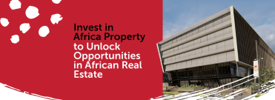
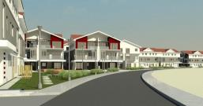
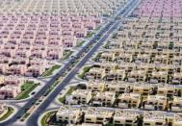
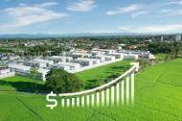
Investing in real estate in Africa can be a lucrative opportunity due to the continent's rapid urbanization, growing population, and increasing demand for housing and commercial spaces. To succeed, investors should consider:
1. Market Research: Analyze factors like population growth, urbanization trends, economic indicators, and demand for different property types in specific regions.
2. Local Partnerships: Collaborate with local real estate professionals for insights, regulatory guidance, and access to resources.
3. Property Types: Assess which property types (residential, commercial, etc.) align with your investment goals and risk tolerance.
4. Risk Assessment: Evaluate risks like political stability, regulatory hurdles, currency fluctuations, and market volatility. Implement risk management strategies and seek professional advice.
5. Infrastructure Development: Consider the impact of infrastructure improvements on property values and economic growth.
6. Due Diligence: Conduct thorough property inspections, financial analysis, legal assessments, and compliance checks.
7. Long-Term Perspective: Embrace a patient approach to achieve sustainable returns and positive impact on local communities.
8. Diversification: Spread risk and capture opportunities by investing in different markets and property types across Africa.
Remember, investing in African real estate requires a deep understanding of local market dynamics, regulatory environments, and cultural nuances. Engaging with local experts, conducting thorough due diligence, and staying informed about market trends are crucial for success. Consult with financial advisors, legal professionals, and real estate experts specializing in African markets to develop a well-informed investment strategy.
Real Estate

Slide 28
EDUCATION
8
1
( wildlife, national parks)

Slide 29
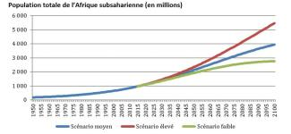
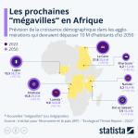
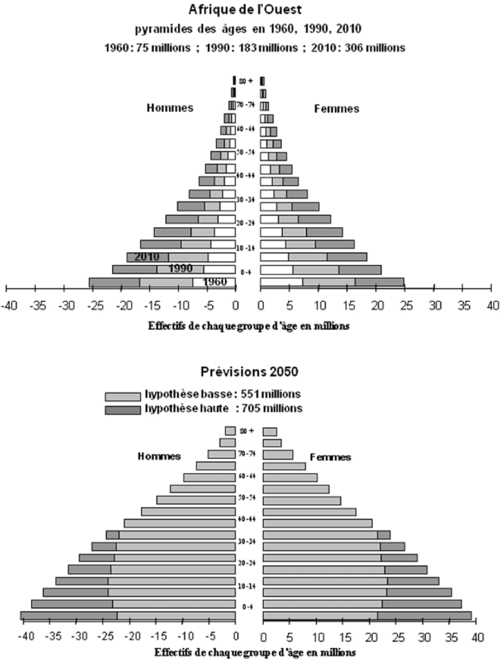
The education sector in Africa offers a significant investment opportunity, driven by factors signaling growth and potential returns. Here are key points on why investing in African education can be lucrative:
1. Rising Demand for Quality Education: Increasing demand for quality education in Africa due to population growth and urbanization fuels opportunities in private schools, vocational training, and online learning.
2. Improving Infrastructure: African countries are enhancing education infrastructure, creating partnerships with private investors to meet the rising need for quality education.
3. Technological Advancements: Adoption of technology in Africa enables innovative educational solutions like e-learning platforms and educational apps, offering profitable investment prospects in the edtech sector.
4. Youth Population: With a large young population, Africa presents a growing market for educational services, from primary to tertiary education and vocational training programs.
5. Government Support: African governments prioritize education investment for economic growth and development goals, offering opportunities for investors through partnerships and incentives.
Investing in African education not only yields financial returns but also enhances human capital, drives innovation, and promotes socioeconomic advancement. By meeting the demand for quality education, leveraging technology, and partnering with government initiatives, investors can shape the future of education in Africa and benefit from a thriving market.
Education

Slide 30
But, that's not all.
9
View your slides wherever you are!

Slide 31


In Central Africa
Oil and gas (Angola, Chad, Gabon)
Mining (copper, zinc, diamonds)
Infrastructure (construction of roads, bridges, airports)
Renewable energies (solar, hydroelectric)

Slide 32
In Central Africa
In Central Africa , growth sectors such as oil and gas occupy a dominant place in the economy of many countries, notably Angola, Chad and Gabon . These countries have rich hydrocarbon reserves, contributing significantly to export earnings and economic growth. Oil and gas exploitation provides investment opportunities in the exploration, production and marketing of these strategic resources .
The mining sector in Central Africa is also promising, with deposits of copper, zinc, diamonds and other valuable minerals . These mineral resources attract investors seeking partnerships for responsible and sustainable mining, thus supporting the economic development of countries in the region. Furthermore, the infrastructure sector is booming in Central Africa, with increasing needs for the construction of roads, bridges, airports and other basic infrastructure to support economic growth and regional development .
Finally, renewable energies , such as solar and hydroelectric energy , represent a sector of the future in Central Africa. With strong potential in terms of natural resources, countries in the region are increasingly investing in clean energy to meet the growing demand for electricity and reduce their dependence on fossil fuels. Renewable energy projects provide investment opportunities in the development of green energy production capacities , thereby contributing to the transition towards a more sustainable and environmentally friendly economy in Central Africa.

Slide 33
Investment incentive
Cameroon and several Central African countries offer attractive incentives for investors wishing to establish themselves in the region. Here are some of the measures put in place to encourage investment:
1 . Special Economic Zones (SEZ) : Cameroon has established Special Economic Zones to encourage investment and job creation. These zones offer tax, customs and regulatory advantages for companies that set up there, thus promoting a climate conducive to business.
2 . Favorable regulatory framework : The Cameroonian government has put in place a regulatory framework favorable to investment, facilitating administrative procedures for companies. Reforms are regularly undertaken to improve the business environment and stimulate investment.
3 . Tax Incentives : Cameroon offers attractive tax incentives for investors, including tax reductions and customs exemptions for investment projects in certain priority sectors.
4 . Access to regional markets : As a member of the Central African Economic and Monetary Community (CEMAC), Cameroon benefits from easier access to regional markets, which provides export opportunities and commercial partnerships in the sub-region.
5 . Financial support : Institutions such as the Bank of Central African States (BEAC) and the Development Bank of Central African States (BDEAC) provide financial support to investors through loans, guarantees and other financial services .
These investment incentives, combined with the economic potential and business opportunities in Central Africa, make the region an attractive choice for investors seeking new markets and strategic partnerships.

Slide 34


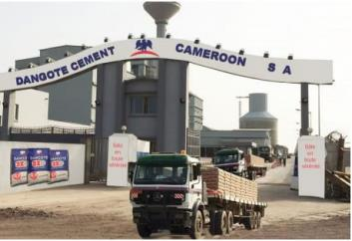

Case
There are several examples of successful businesses in Cameroon and Central Africa that have managed to take advantage of investment opportunities in the region. Here are some case studies of companies that have seen notable success :
One of the country's leading brewing companies, producing and distributing a wide range of beers and soft drinks. The company enjoys a strong presence in the local and regional market, thanks to continuous investments in the quality of its products and in its production and distribution infrastructures.
One of the main international banks present in Cameroon and Central Africa. The local subsidiary offers a full range of financial services to individuals, businesses and institutions, leveraging its expertise and financial strength to meet the needs of the local market.
A company of the Dangote Group , one of the largest industrial conglomerates in Africa. Dangote Cement Cameroon operates in the cement sector in Cameroon, with significant production capacity and a significant presence on the local market. The company has invested in modern technologies and sustainable practices to ensure its growth and profitability.
These companies are examples of success in different sectors of activity in Cameroon and Central Africa, demonstrating the economic potential and investment opportunities in the region. Testimonials from other satisfied investors and analyzes of investment returns can also shed light on the advantages and benefits of expanding into these growing markets.

Slide 35
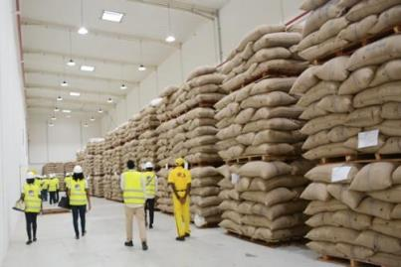
Testimonials
Cocoa and derivatives: exports bring in 512 billion FCFA to Cameroon in 2023 (+10%)
Exports of cocoa beans and its derivatives brought in overall revenues of 512 billion FCFA in Cameroon in 2023 , up 10.4% compared to 2022, despite a drop in the volume of exports. 180,095 tonnes of raw beans were exported, generating more than 359 billion FCFA, or 12% of the country's export revenues that year.
Exports of derivative products also contributed, with 73,236 tonnes sold for a total of 153 billion FCFA . The increase in income is explained by the high price of beans on the world market, due to reduced production in Ghana and Ivory Coast, the main world producers.
Frédéric Nonos,
Cocoa and derivatives: exports bring in 512 billion FCFA to Cameroon in 2023 (10%) - Business in Cameroon

Slide 36

Testimonials
Himore Medical has developed the Cardiopad , the first African medical tablet
Arthur Zang , developed the Cardiopad , unanimously presented as being the first African medical tablet.
This technological innovation has received several international awards and today allows its author to embark on a new innovative project.
The very latest, Arthur Zang received it on May 26, 2016 in the Tanzanian capital. This is Africa 's gold medal Prize for Engeneering Innovation, organized by the Royal Academy of Engineering in the United Kingdom. This medal comes with a reward of 5,000 pounds, or approximately 23 million CFA francs. The Cameroonian engineer was chosen among 900 candidates from 42 African countries.
IC51.pdf (investincameroun.com)

Slide 37
LET’S CONCLUDE
These business opportunities demonstrate the economic potential of the region and invite investors and entrepreneurs to explore different avenues to develop their activities in Cameroon and Central Africa.
Business opportunities in Cameroon and Central Africa are numerous and diverse. In addition to the growth sectors developed above, here are some key sectors and industries that also offer interesting prospects for businesses and entrepreneurs:
1. The agro-industry sector: Cameroon and Central Africa have vast agricultural and agri-food resources. Investment opportunities in agricultural production, food processing, export of agricultural products, etc., are promising.
2. Infrastructure and public works: The region has a significant need for basic infrastructure, such as roads, bridges, water and sanitation networks, renewable energies, etc. Investments in this area are essential for economic and social development.
3. The new technology sector : With the rapid development of information and communication technologies in Central Africa, opportunities in digital technologies, start-ups, IT services, etc., are booming.
4. The tourism and hospitality industry: Cameroon has a rich cultural, natural and tourist diversity. Investments in the tourism sector, including hotels, travel agencies, tourist attractions, etc., offer growth prospects.
5. The energy sector: Central Africa is full of energy resources such as oil, gas, hydroelectricity, etc. Investment opportunities in power generation, renewable energy, energy efficiency, etc., are promising.
6. Distribution and retail markets: With a growing population and an emerging middle class, Cameroon and Central Africa offer opportunities in retail, consumer product distribution, franchising, etc.

Slide 38



WELCOME TO CAMEROON

